Slide 1
Ense 470 milestone 5
Jeremy Cross
Iden Ellia
Abdullah Alasmari

Slide 2
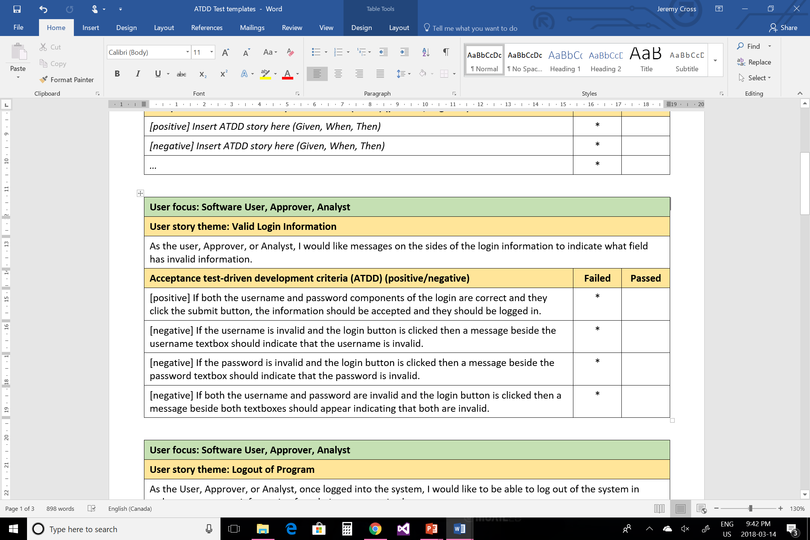
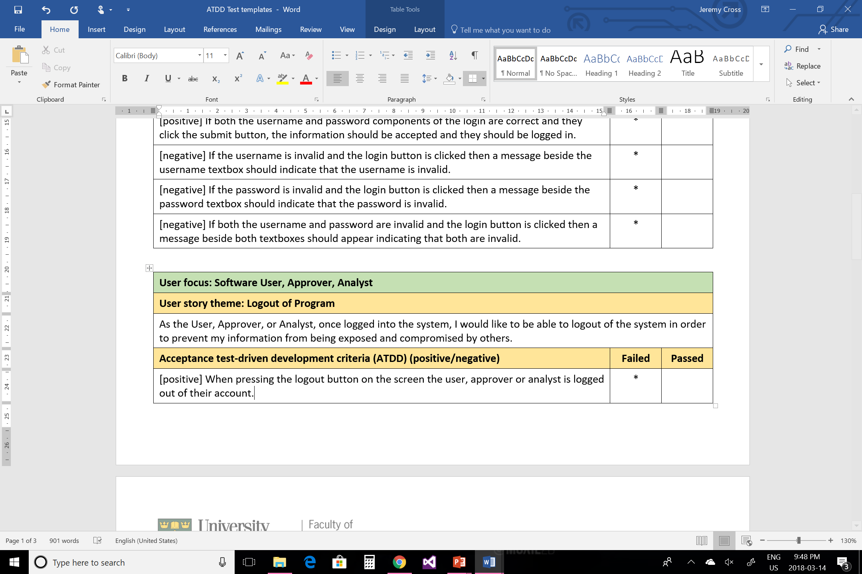
ATDD templates (User, approver, analyst)

Slide 3
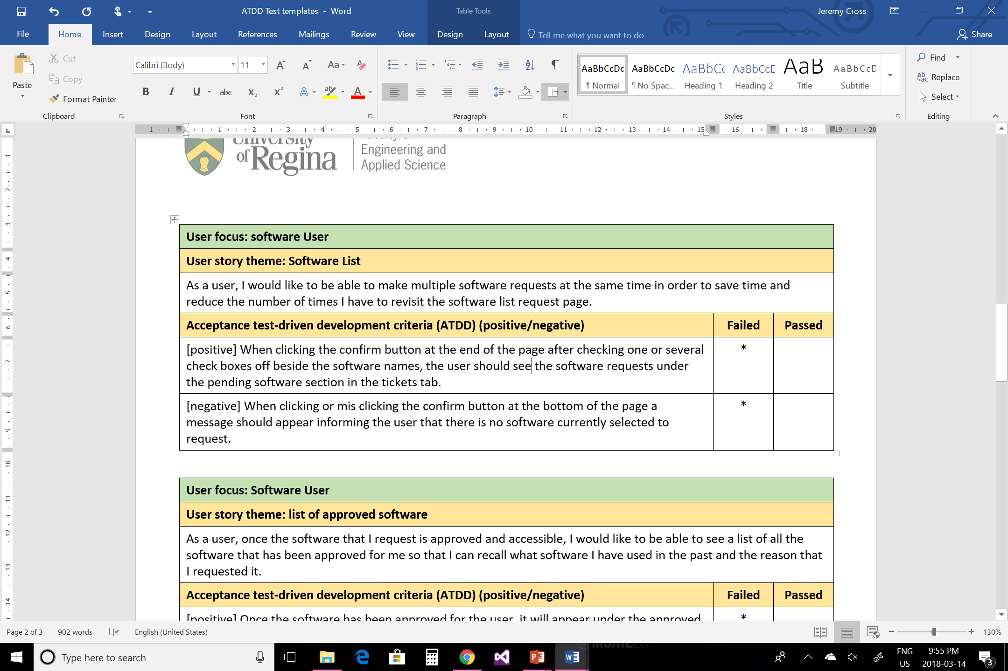
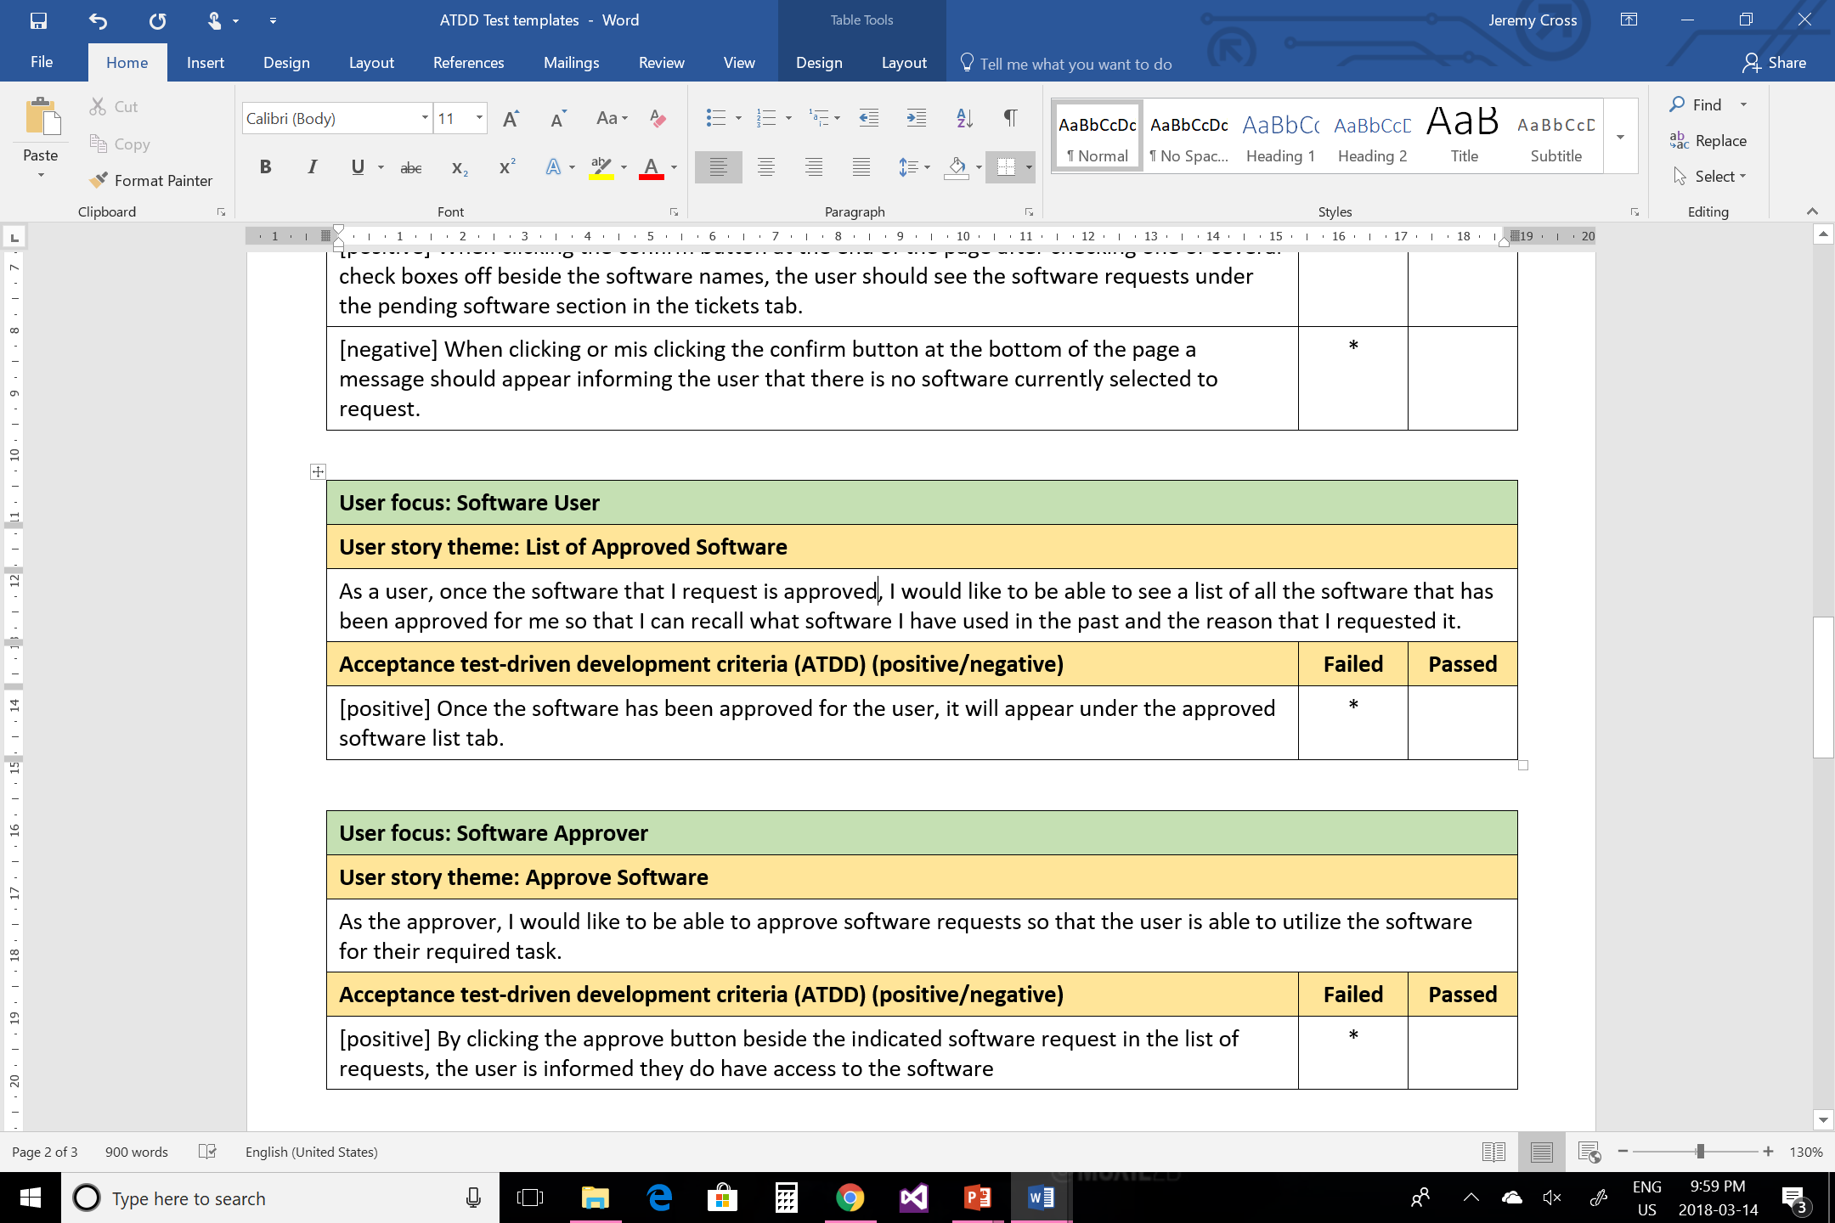
Atdd templates (Users)

Slide 4
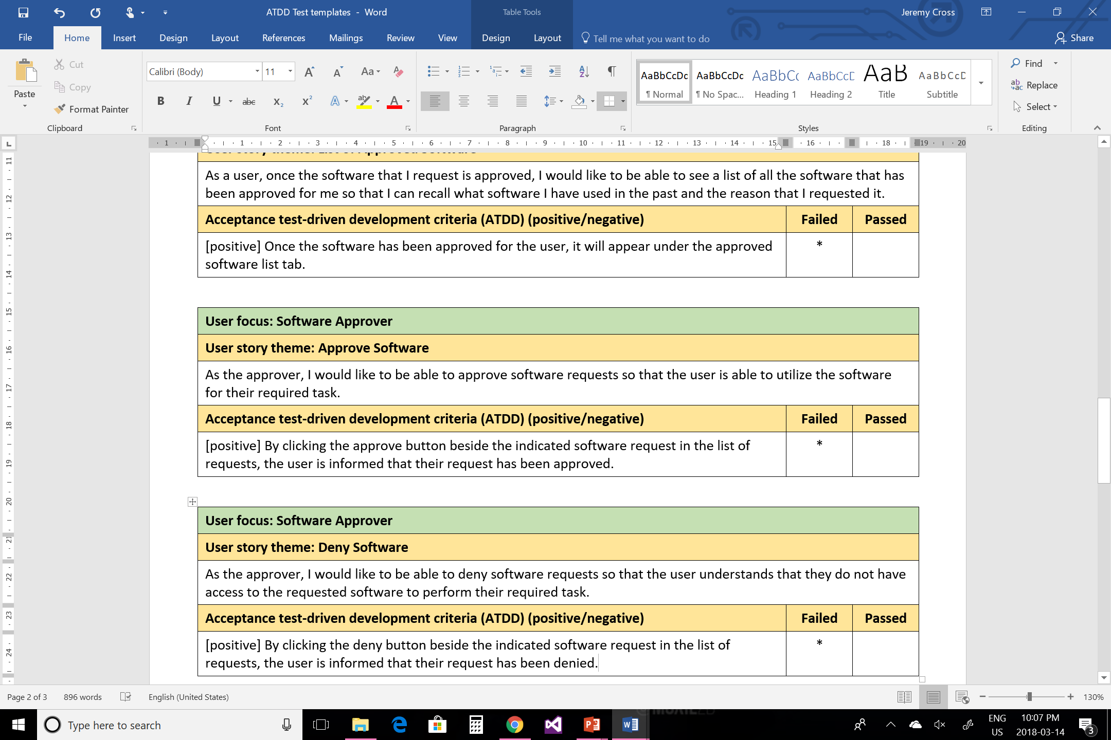
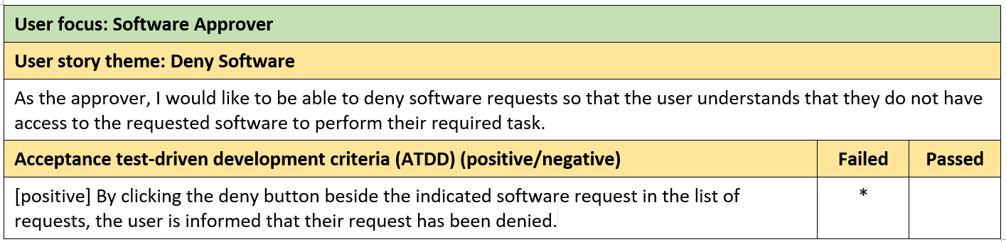
Atdd templates (approver)

Slide 5
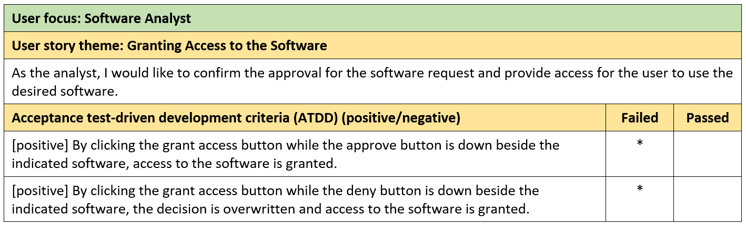
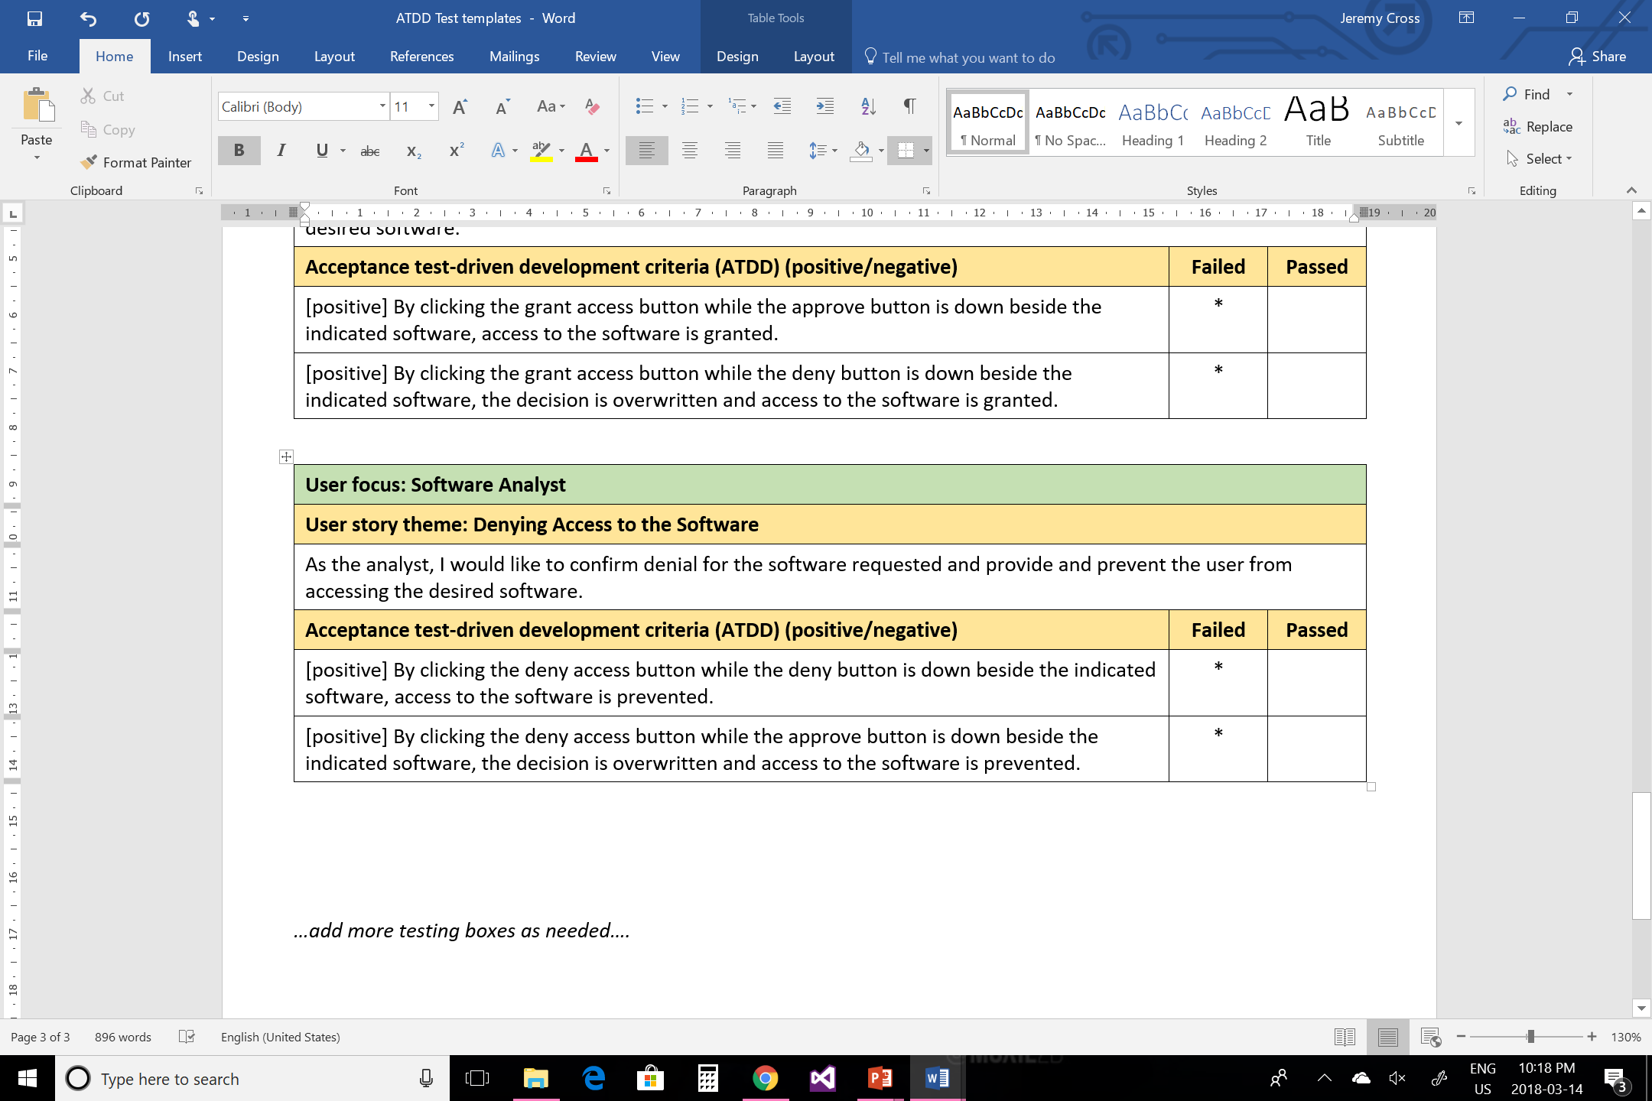
Atdd templates (analyst)

Slide 6
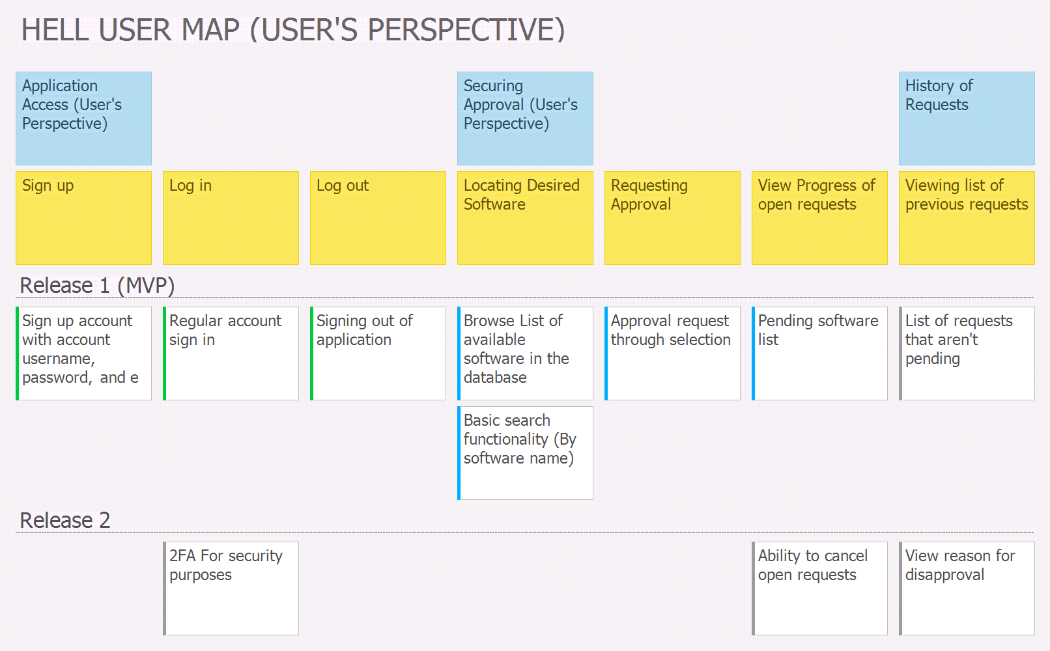

Slide 7
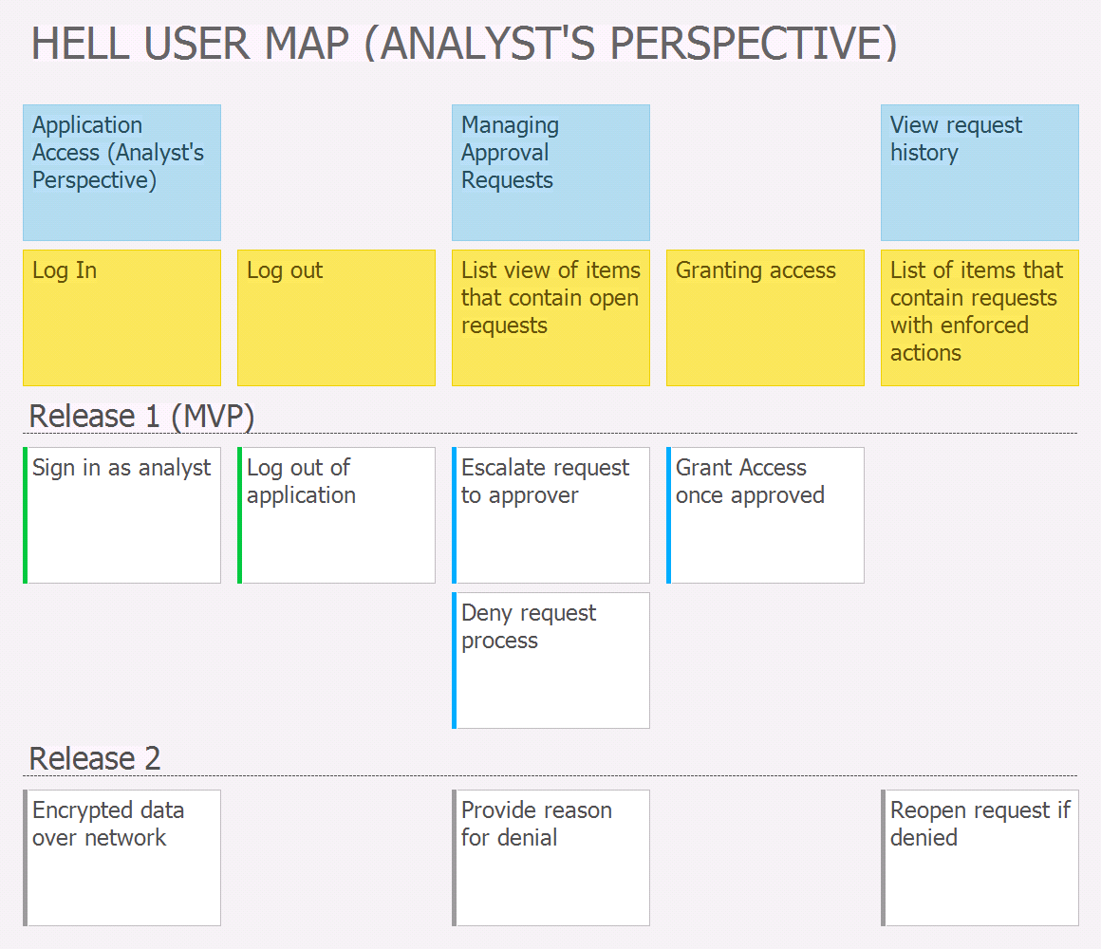

Slide 8
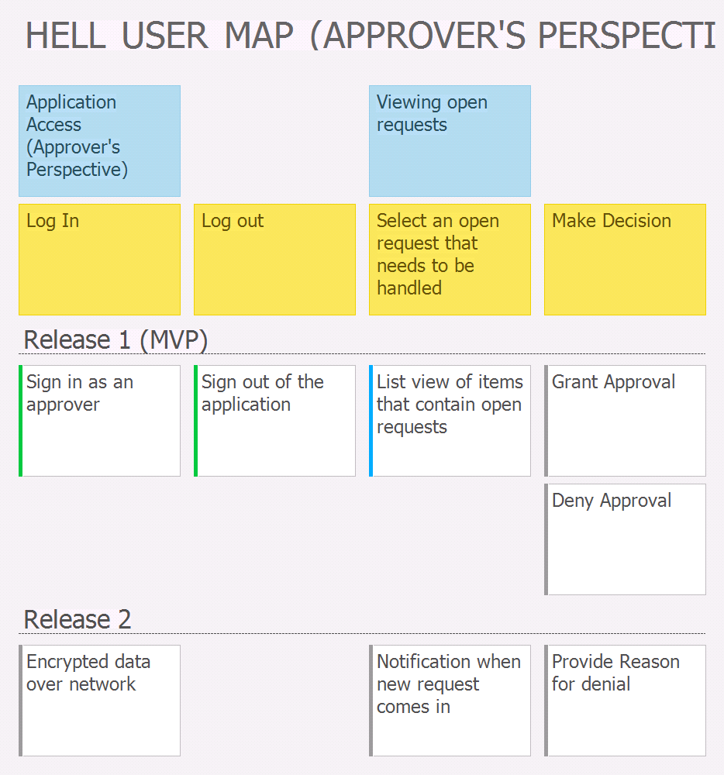

Slide 9
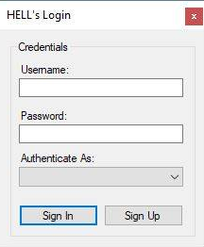
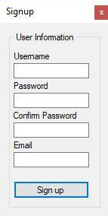
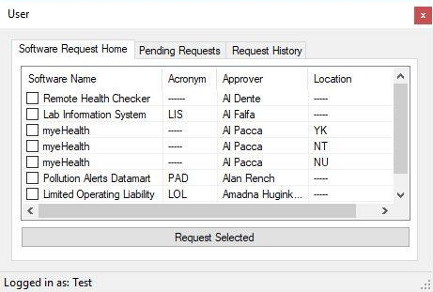
Interface screen shots

Slide 10
Changes & Misc.
Have your plans changed since your group’s initial conception and project evolution
We split our user story map into 3 components, a user, approver and analyst perspective

Slide 11
Group reflection
How did you feel about this milestone? What did you like about it? What did you dislike?
The content from the previous millstones such as the user story map and the lo-fi prototypes were helpful in creating the ATDD templates.
What did you learn about yourself as you collaborated and worked through this milestone?
We learned how to take the ideas built in the user story map and the visual representations of the lo-fi prototypes and create testing scenarios around them.
How will you use what you have learned going forward?
We have learned what kind of scenarios to test for with our program as it becomes further constructed.
What “stuff & things” related to this milestone would you want help with?
We were somewhat unclear as to what the positive and negative ATDD’s were.

Slide 12
Questions?

